Slide 1
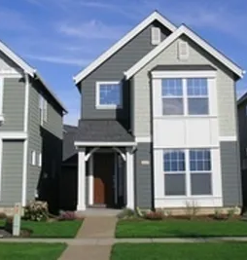
PROJECT ON EXPLORATORY DATA ANALYSIS OF HOUSING DATA
NAME: S. SUJANA KUMARI AFFILIATION: DIGICROME ACADEMY

Slide 2
PROJECT OVERVIEW
In the dynamic landscape of the residential real estate market, determining an optimal and competitive price for a house is a multifaceted challenge. As a key member of the analytics team in a leading real estate company, your task is to conduct a comprehensive analysis to identify and understand the myriad variables that significantly influence house prices. By leveraging advanced data analytics techniques and visualization tools, your goal is to uncover patterns, correlations, and trends within the dataset, enabling the company to make informed decisions and strategically position properties for better business opportunities.
The real estate industry is inherently complex, influenced by numerous factors that collectively impact the pricing of residential properties. The task at hand is to navigate through this complexity and extract meaningful insights from the available data. As an analytics professional, you are entrusted with the responsibility to not only identify the key variables affecting house prices but also to provide actionable recommendations based on your findings.
The dataset at your disposal comprises diverse parameters such as location, size, amenities, market trends, economic indicators, and historical transaction data. These variables contribute to the intricate web of pricing dynamics, and your role is to unravel their interdependencies through meticulous analysis.
Your analysis should go beyond simple correlation assessments, delving into advanced statistical methods and visualizations. By employing regression models, clustering techniques, and compelling visual representations, you are expected to discern hidden patterns and outliers that can significantly impact the pricing strategy.
The ultimate objective is to empower the real estate company with a deeper understanding of the market forces at play. Your insights will guide the pricing strategy, facilitating better decision-making for property acquisition, sales, and negotiation. Moreover, your findings may uncover opportunities for optimizing property values, enhancing customer satisfaction, and gaining a competitive edge in a dynamic and ever-evolving real estate landscape.

Slide 3
INTRODUCTION TO EDA
DEFINITION OF EDA: Exploratory Data Analysis is a crucial first step in the data analysis process, providing valuable insights into the structure, patterns, and quality of the data that inform subsequent analyses and decision-making.
Importance of EDA in Data Science: Exploratory Data Analysis is a critical step in the Data Science process, laying the foundation for subsequent analyses, modeling, and decision-making. By thoroughly exploring and understanding the data, analysts can extract valuable insights that drive business value and inform data-driven decision-making.
OBJECTIVE OF EDA: The primary objective of EDA is to gain a deeper understanding of the data, uncover interesting patterns and relationships, and lay the groundwork for further analysis and modeling.

Slide 4
DATA DESCRIPTION
SOURCE OF HOUSING DATA: The data used for the analysis is provided by Next Hikes.
FEATURES/VARIABLES INCLUDED: There are around 81 features and variables included in the data. The most common and important variables include Total living area in square feet, No of bedrooms, bathrooms, kitchen, Garage capacity etc.
DATA SIZE AND FORMAT: The data has around 1460 rows and 81 columns in the form of csv.
NECESSARY LIBRARIES TO BE IMPORTED:
import pandas as pd
import numpy as np
import seaborn as sns
import matplotlib.pyplot as plt

Slide 5
METHODOLOGY
Data Loading and Initial Exploration:
a. Importing the Dataset.
b. Displaying the First Few Rows of Data
c. Basic Summary Statistics (mean, median, min, max, etc.)
Data Cleaning and Preprocessing:
a. Handling Missing Values.
b. Removing Duplicates.
c. Checking for Data Integrity Issues.
Exploratory Data Analysis (EDA):
a. Univariate Analysis: Conduct a univariate analysis to understand the distribution of key variables like house prices. Utilize histograms, kernel density plots, or other visualizations to gain insights into the data.
b. Multivariate Analysis: Perform multivariate analysis to understand the correlations and dependencies between various features. Utilize techniques like correlation matrices or scatterplot matrices for a comprehensive view.

Slide 6
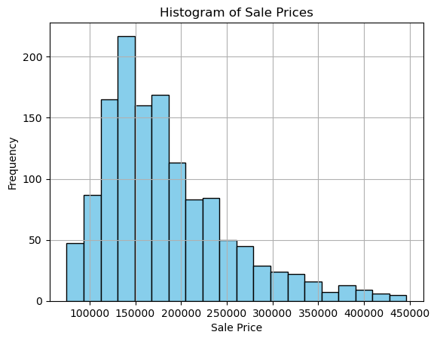
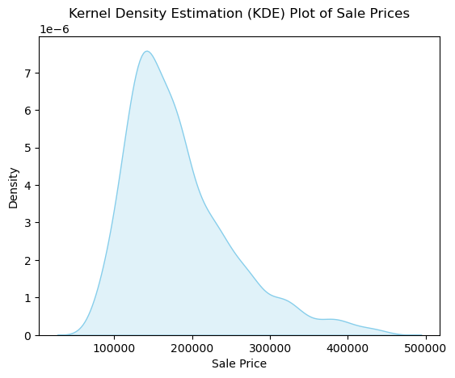
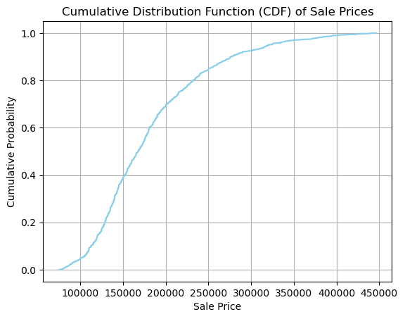
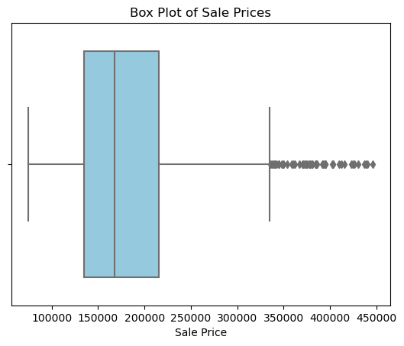
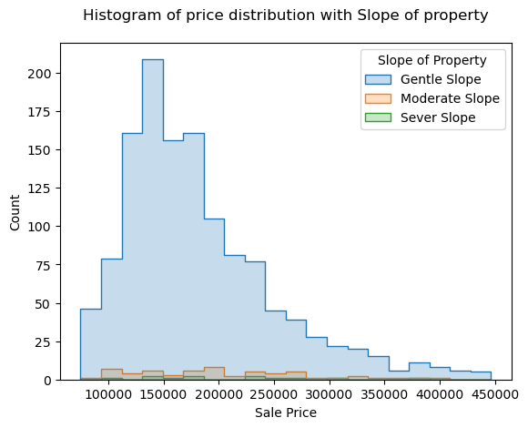
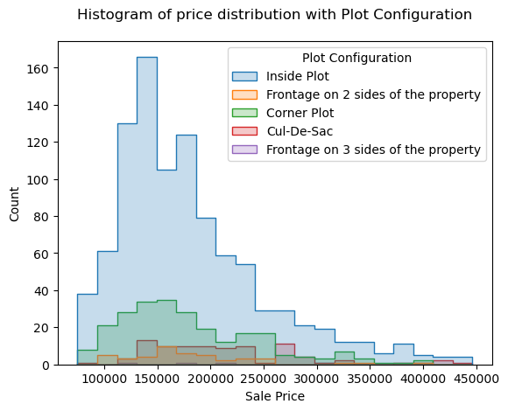
METHODOLOGY
Exploratory Data Analysis (EDA):
a. Univariate Analysis: Conduct a univariate analysis to understand the distribution of key variables like house prices. Utilize histograms, kernel density plots, or other visualizations to gain insights into the data.

Slide 7
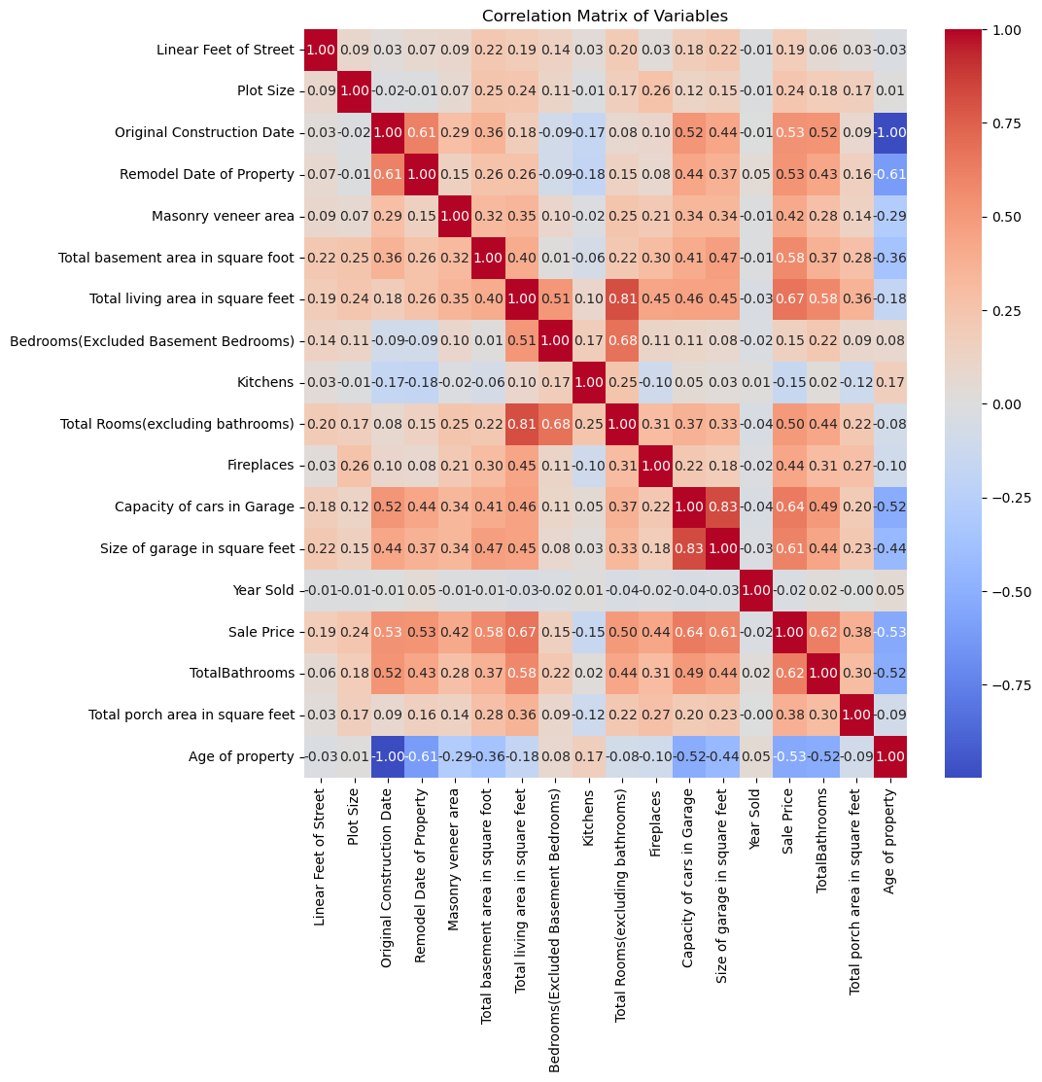
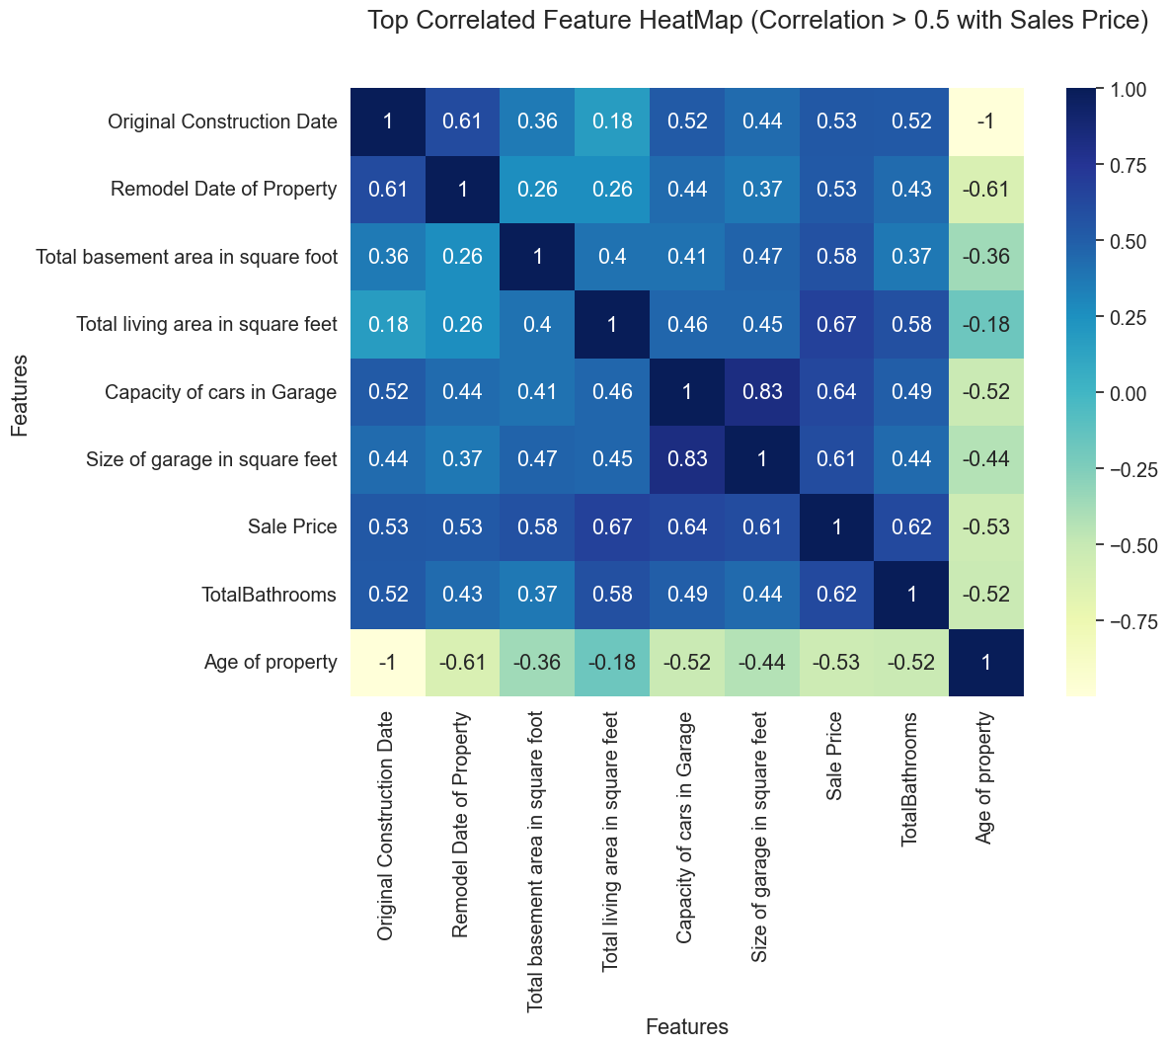
METHODOLOGY
Exploratory Data Analysis (EDA):
a. Multivariate Analysis: : Perform multivariate analysis to understand the correlations and dependencies between various features. Utilize techniques like correlation matrices or scatterplot matrices for a comprehensive view.

Slide 8
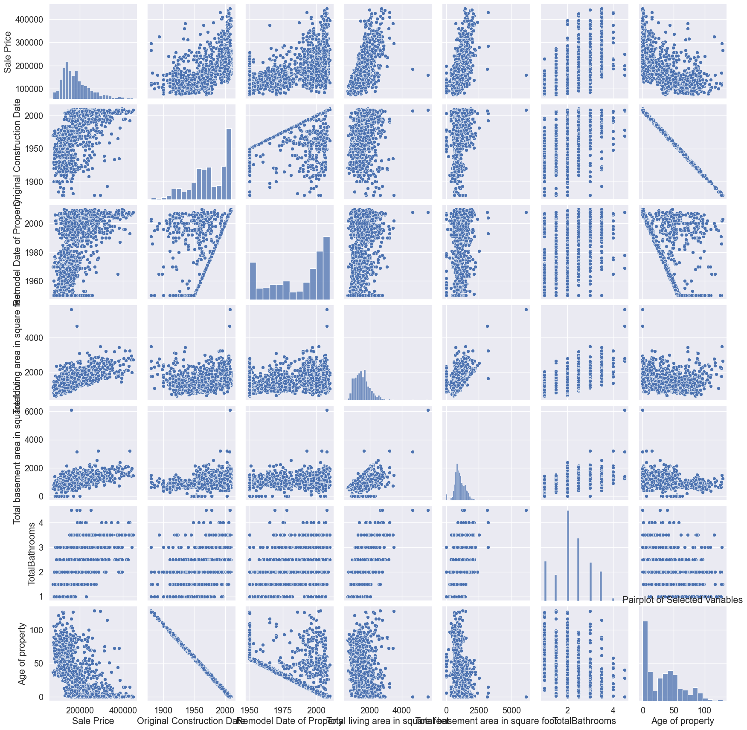
METHODOLOGY
Multivariate Analysis: Pair plots for comprehensive view.

Slide 9
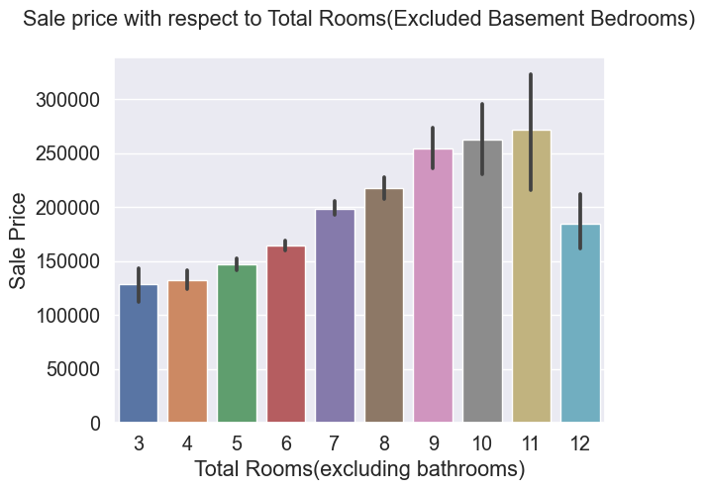
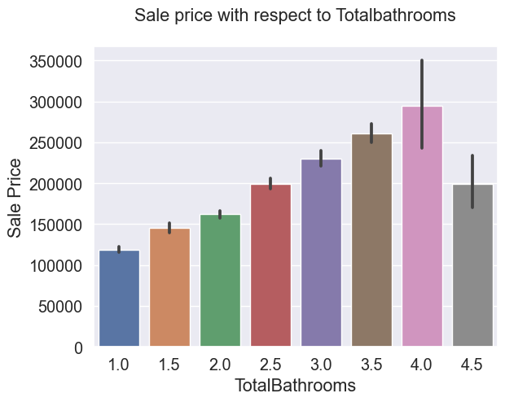
METHODOLOGY
Multivariate analysis: Bar plots for multivariate analysis for better comprehensive view

Slide 10
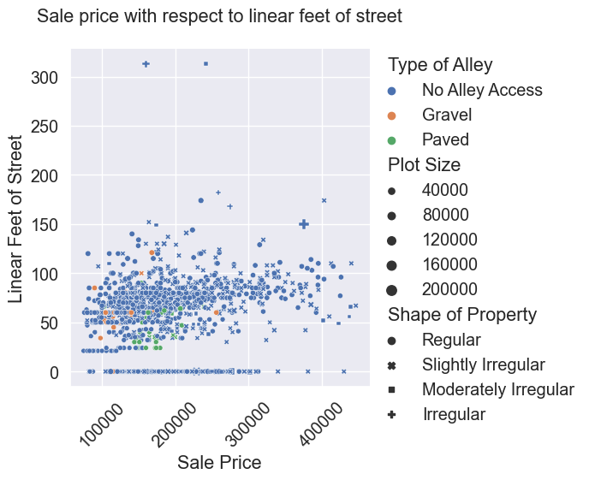
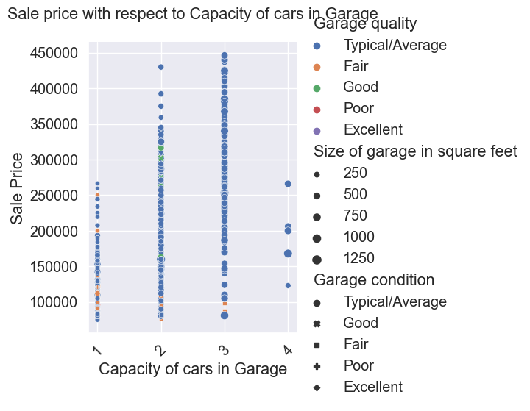
METHODOLOGY
Multivariate analysis: Scatterplots in multivariate analysis for better comprehensive view.

Slide 11
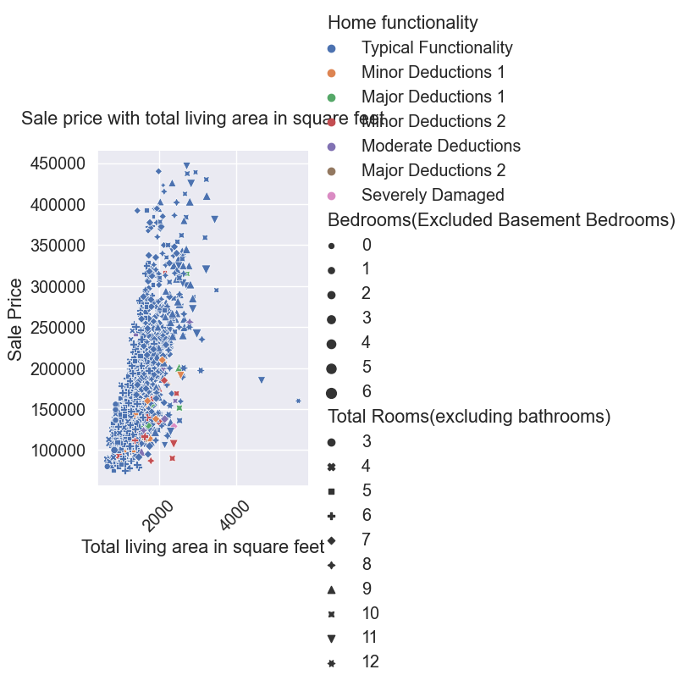
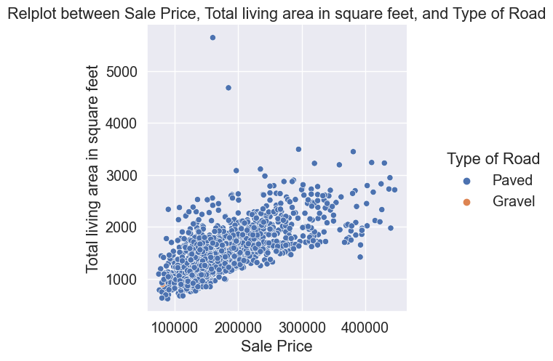
METHODOLOGY
Multivariate analysis: Scatterplots and relational plots in multivariate analysis for better comprehensive view.

Slide 12
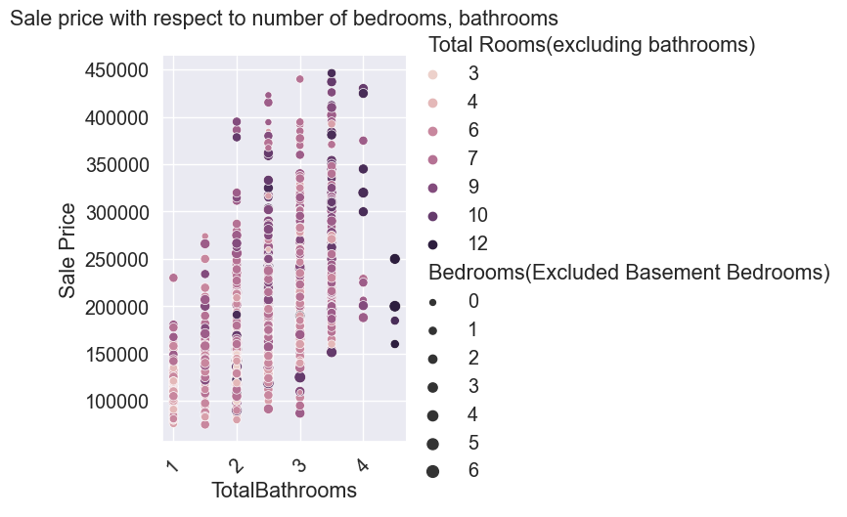
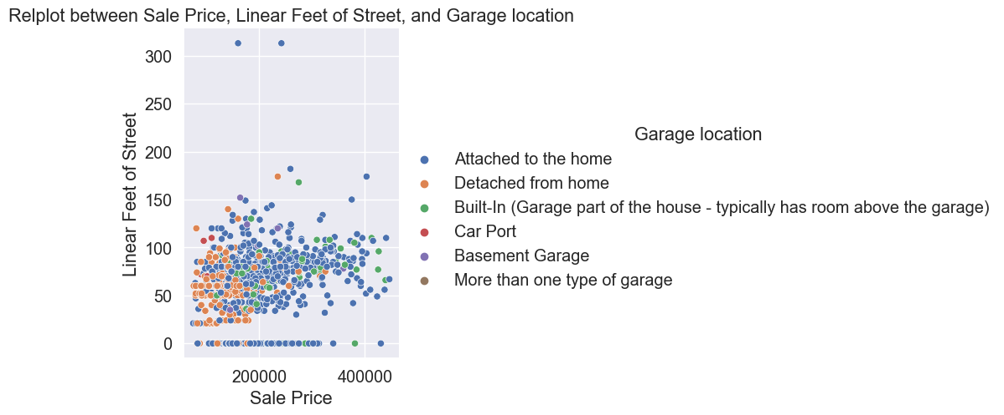
METHODOLOGY
Multivariate analysis: Scatterplots and relational plots in multivariate analysis for better comprehensive view.

Slide 13
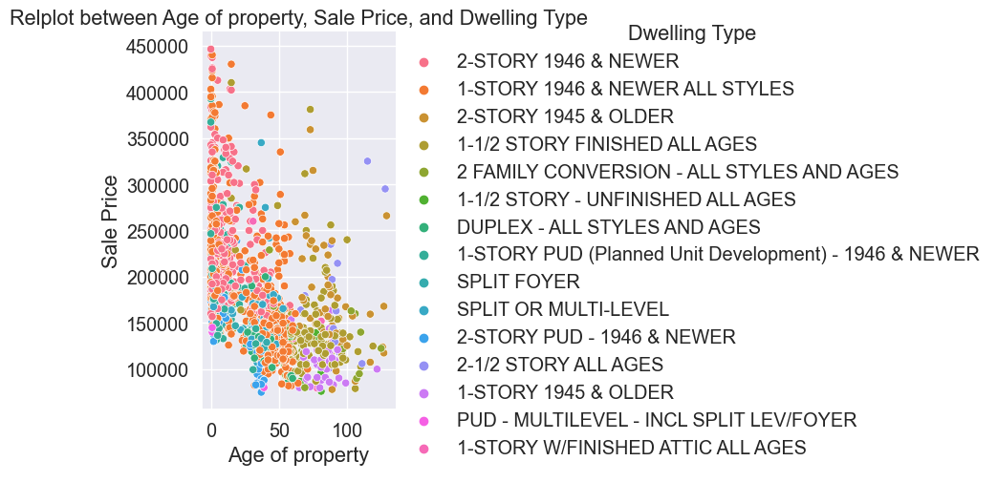
METHODOLOGY
Multivariate analysis: Scatterplots and relational plots in multivariate analysis for better comprehensive view.

Slide 14
METHODOLOGY
Multivariate analysis: Scatterplots and relational plots in multivariate analysis for better comprehensive view.

Slide 15
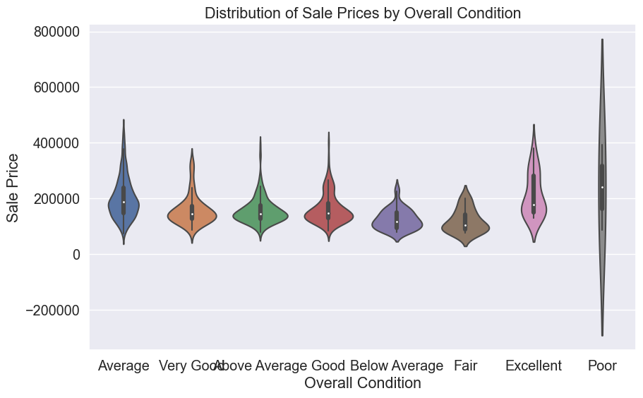
METHODOLOGY
Multivariate analysis: Violin plot in multivariate analysis for better comprehensive view.

Slide 16
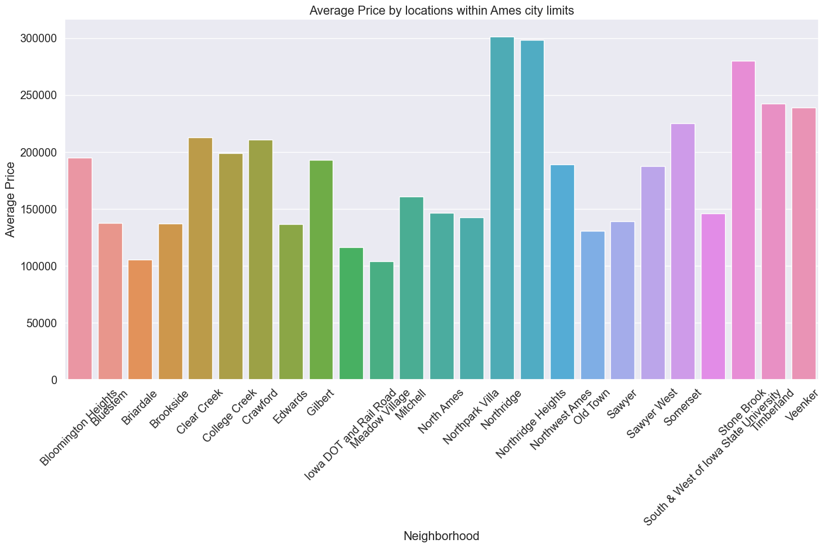
METHODOLOGY
Multivariate analysis: Bar plots in multivariate analysis for better comprehensive view.

Slide 17
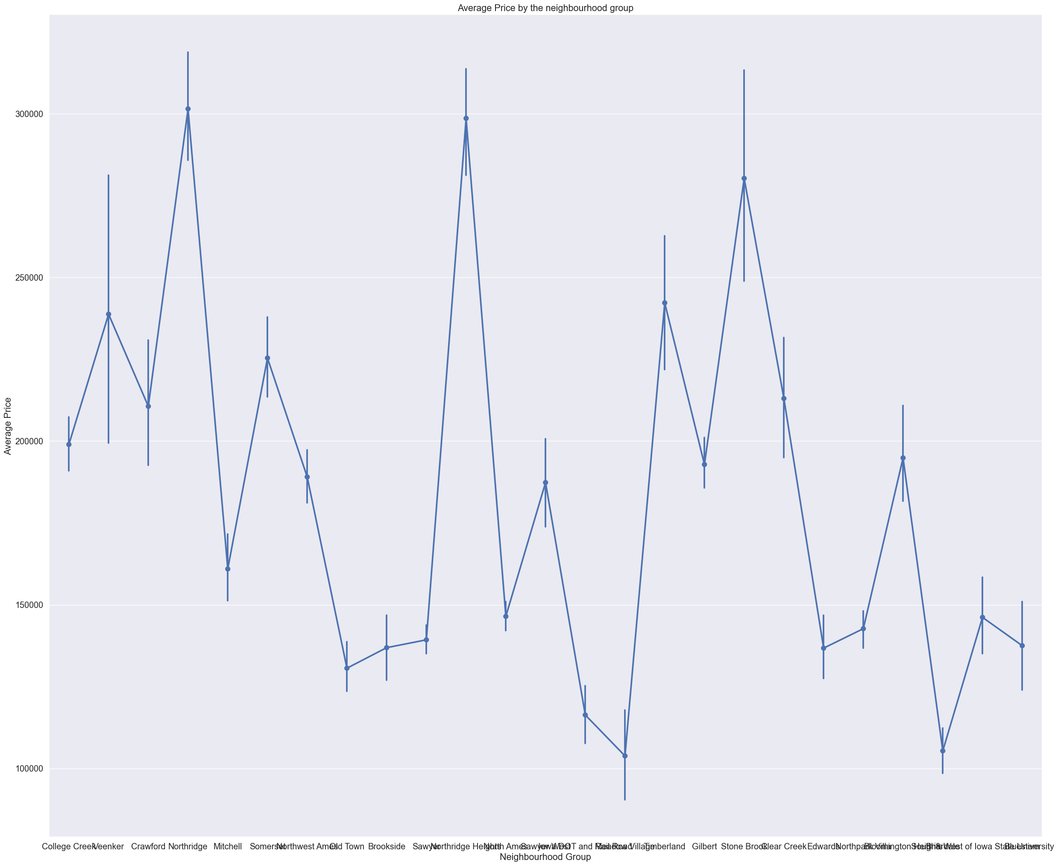
METHODOLOGY
Multivariate analysis: Point plots in multivariate analysis for better comprehensive view.

Slide 18
METHODOLOGY
4. Feature Engineering: Introduce new variables that might enhance the model's ability to predict house prices. For instance, calculate the price per square foot or engineer a feature representing the property's age.
5. Feature Engineering and Size Impact: Explore relationships between key features (e.g., number of bedrooms, bathrooms, square footage) and house prices. Identify how these features collectively contribute to the valuation.
6. Market Trends and Historical Pricing: Analyse the dataset temporally, looking at trends in house prices over different periods. Understand how external factors, such as economic indicators, may have influenced these trends.

Slide 19
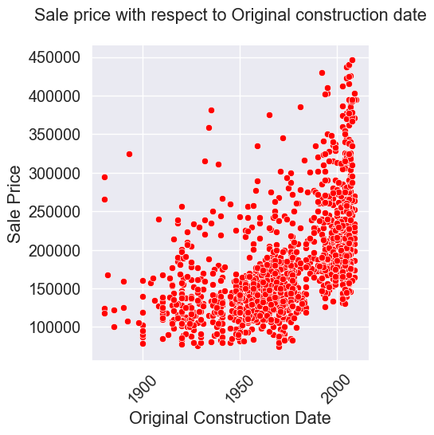
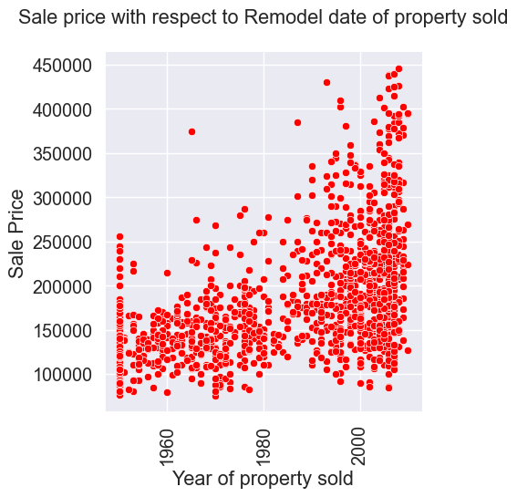
METHODOLOGY
Market Trends and Historical Pricing: Visualization of Market trends and historical pricing using scatter plots

Slide 20
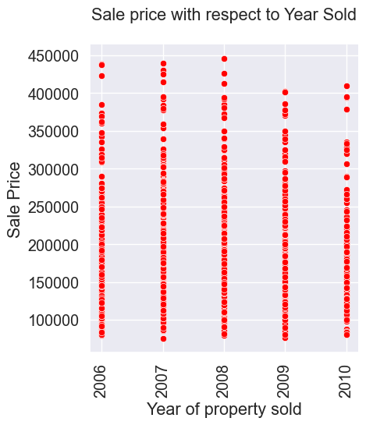
METHODOLOGY
Market Trends and Historical Pricing: Visualization of Market trends and historical pricing using scatter plots

Slide 21
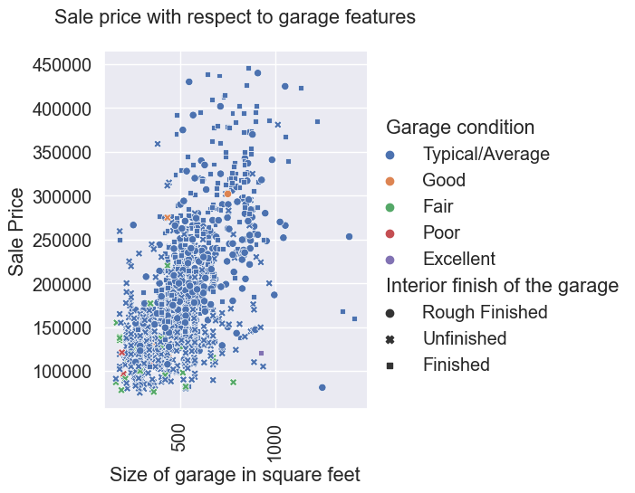
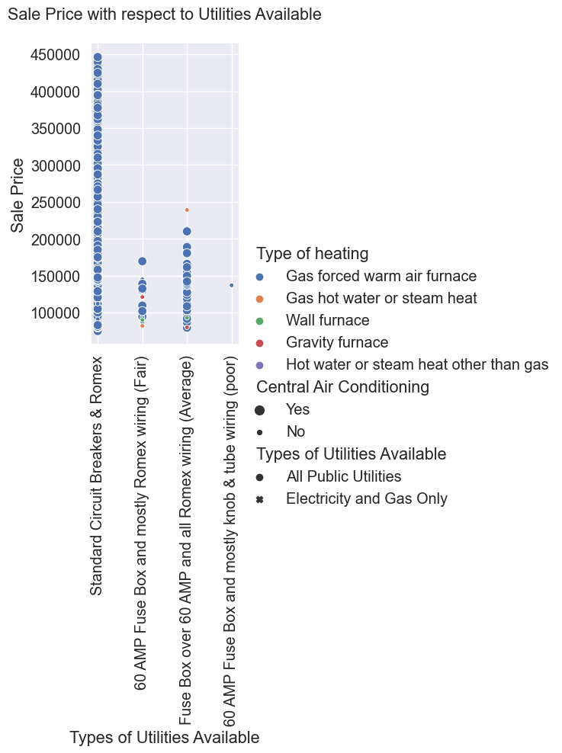
METHODOLOGY
7. Customer Preferences and Amenities: Examine the dataset to understand how specific amenities (e.g., swimming pool, garage) impact house prices. Analyse customer feedback or reviews to gauge the perceived value of these amenities.

Slide 22
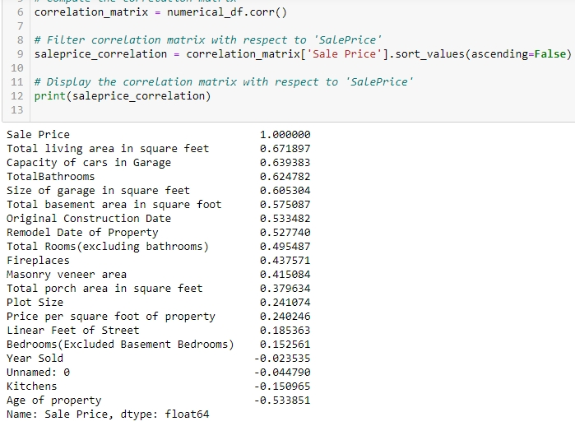
CONCLUSION
From the Exploratory Data Analysis performed of the housing data it is observed that the most correlated features of the target variable Sale price are percentage wise as below

Slide 23
CONCLUSION
FINAL CONCLUSION: From the exploratory data analysis the numerical features mostly impacting the sale price include:
Total living area in square feet: (0.67% correlated) It is directly proportional to the Sale Price. Higher the total living area higher will be the sale price.
Capacity of cars in garage: (0.63% correlated) It is directly proportional to the Sale Price. Higher the capacity of cars in garage higher will be the sale price.
Total Bathrooms: (0.62% correlated) It is directly proportional to the Sale Price. Higher the number of bathrooms higher will be the sale price.
Size of garage in square feet: (0.60% correlated) It is directly proportional to the Sale Price. Higher the size of the garage higher will be the sale price.
Total basement area in square feet: (0.57% correlated) It is directly proportional to the Sale Price. Higher the total basement area in square feet higher will be the sale price.

Slide 24
CONCLUSION
FINAL CONCLUSION: The analysis of the data from the univariate and multivariate analysis and observing different plots like scatter plots, bar plots, kde plots, relational plots etc. include:
The properties of the property are higher in the following conditions:
Houses having total 7-10 rooms, 1 kitchen, and shape of property Regular/Slightly Irregular.
Houses having total living area between 1500-2500 sqr ft, size of garage 500-800 square feet.
Having Garage attached to home, 2-3 car parking capacity, Average quality and condition of garage.
Houses having low age of property, means house constructed and sold within 20 years of construction

Slide 25

NAME: S. Sujana Kumari
THANK YOU

